Slide 1
Mobile Phone Data Security
Praveen Menon
Abhishek Bodas
Anurag Repaka

Slide 2
Introduction
The Agent: Identify if the data in the mobile is secure based on the software features.
Why is this important:
Mobile device security protects your data from security threats that lead to data breaches
It can be used to analyse whether a guy’s data in his mobile phone is secure or not based on some of his decisions and usage habits.

Slide 3
The Scenario
Bob is a young guy, who uses an Android phone. He uses Norton antivirus for protecting his data. Since his smartphone has lots of applications, Bob saves all his password in Dashlane password manager. His phone has options for screen pattern lock and face recognition lock. He is not a guy who would spend time on updating his OS and there is an Android Pie OS update available in his settings and his Gmail apps are also not updated. He wants to play with the phones Kernel and often roots his phone and installs games through torrent. Bob used APKMirror to install third party application for installing rejected and unauthorised mobile application.

Slide 4
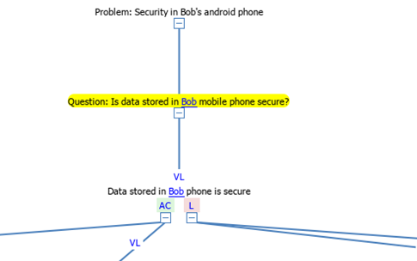
Reasoning Tree

Slide 5
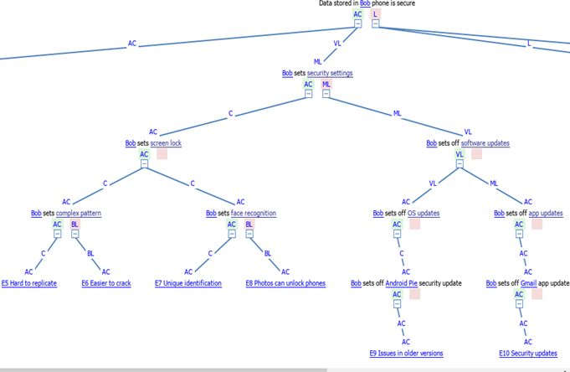
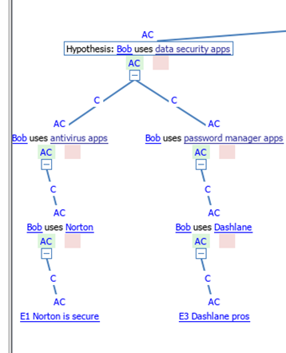
Reasoning Tree

Slide 6
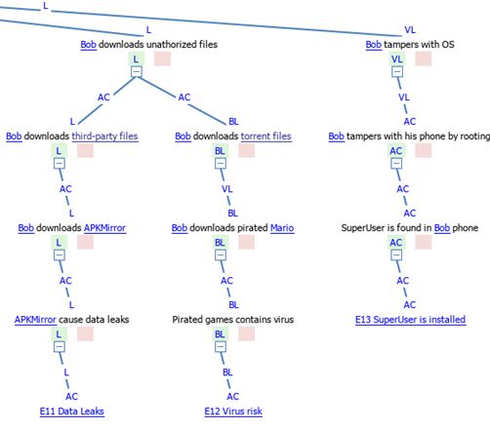
Reasoning Tree

Slide 7
Modeling-based ontology development

Slide 8
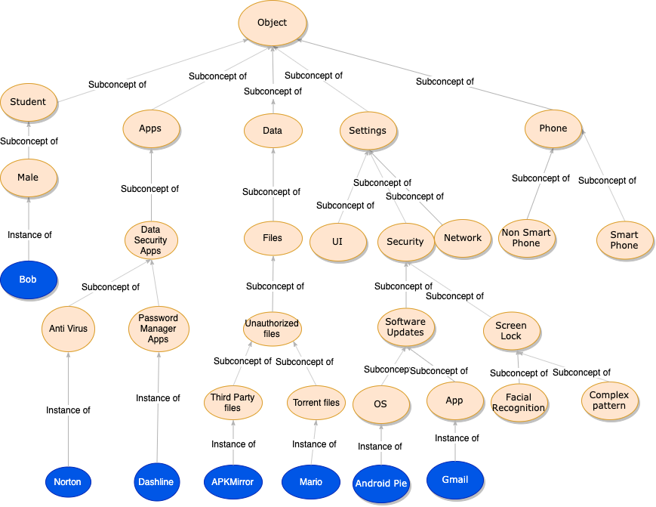
Ontology Fragment

Slide 9
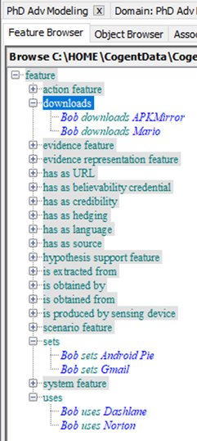
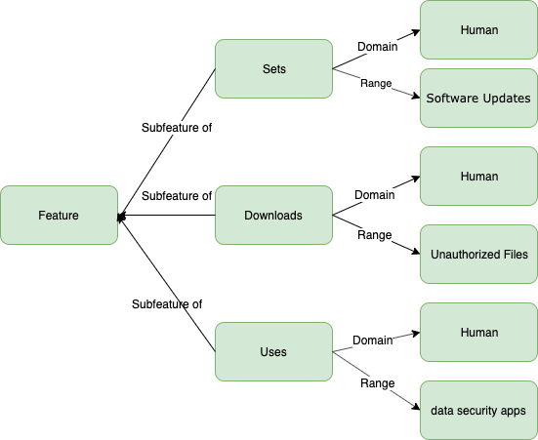
Feature Definitions

Slide 10
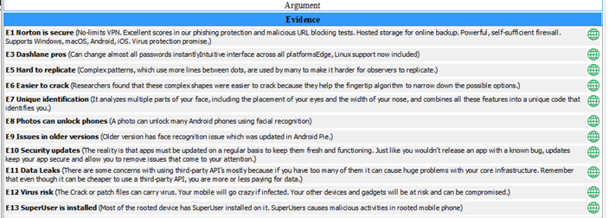
Evidence

Slide 11
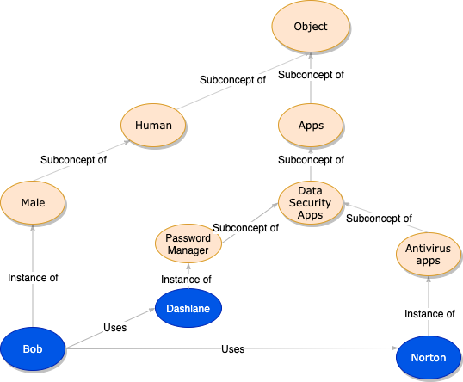
Ontology Fragment

Slide 12
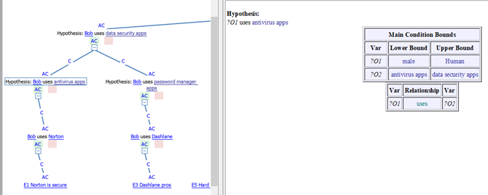
Learned Rule

Slide 13
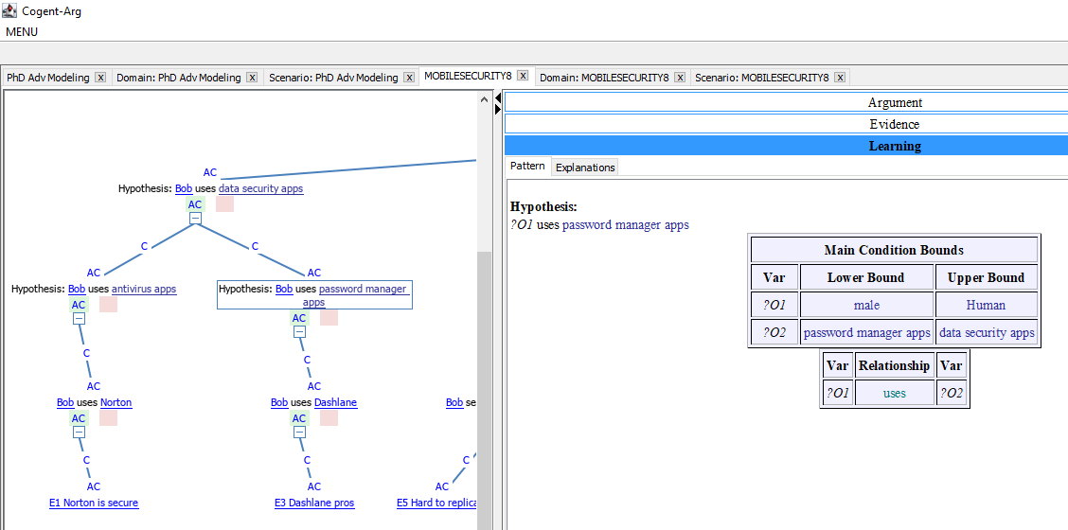
Learned Rule

Slide 14
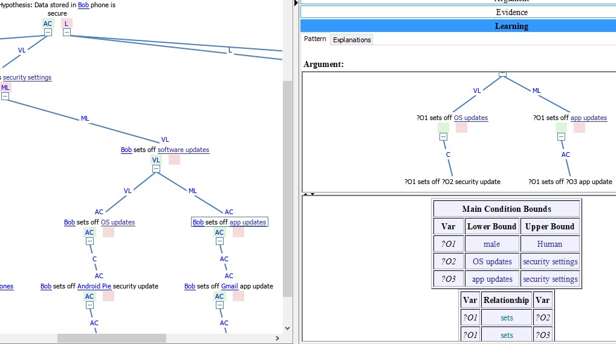
Learned Rule

Slide 15
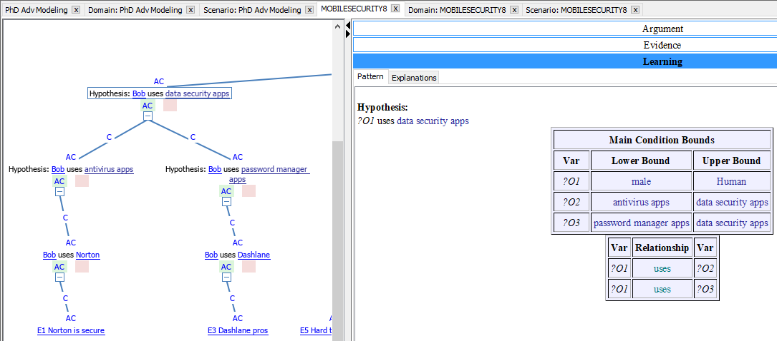
Learned Rule

Slide 16
Bibliography
https://ww.9to5google.com/2019/12/09/pixel-4-december-ota/
https://www.pcmag.com/review/327977/symantec-norton-security-deluxe
https://www.devdigital.com/blog/detail/third-party-apis-pros-cons
https://nakedsecurity.sophos.com/2019/01/08/facial-recognition-on-42-android-phones-beaten-by-photo-test/

